Slide 1

Locating Afghan Restaurants in New York
Vinayak K Prasad

Slide 2
Afghanistan and the United States (US)
- Afghanistan is a country that has been in bad shape over the last decade or two because:-
Due to the many wars beginning with invasion of Russia.
The Taliban
There are a number of asylum seekers coming into New York who need jobs and food.
This report explores which neighborhoods and boroughs of New York have the most as well as the best Afghan restaurants, to help people who have come from a war torn country feel a little accepted.
Additionally, I will attempt to answer the questions “Where should I open an Afghan Restaurant ?” and “Where should I stay If I want great Afghan food?

Slide 3
Data Acquisition and Cleaning
The Data was collected from https://cocl.us/new_york_dataset and cleaned and processed into a dataframe and New York City data containing neighborhood boundaries was obtained from the data source:https://data.cityofnewyork.us/City-Government/Borough-Boundaries/tqmj-j8zm
In total there were 106 Neighborhoods along with 5 Boroughs.
The data contained the Neighborhood, Borough and its respective Latitude and Longitude obtained from GeoLocater.

Slide 4
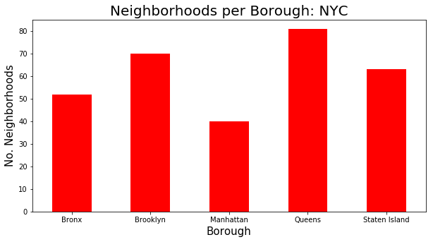
The number of Neighbourhoods in each Borough
Queens has the largest number of Neighbourhoods.
Manhattan has the lowest number.

Slide 5
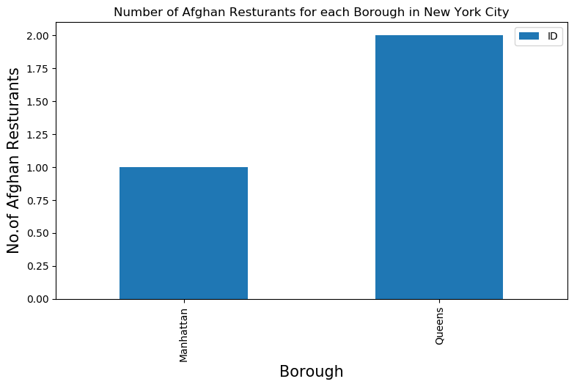
The Number of Restaurants in each Borough
It is a rather surprising thing to see that under the foursquare API only three restaurants in Ney York qualify to be Afghan Restaurants.
We can see that Queens has the most number of Afghan Restaurants.

Slide 6
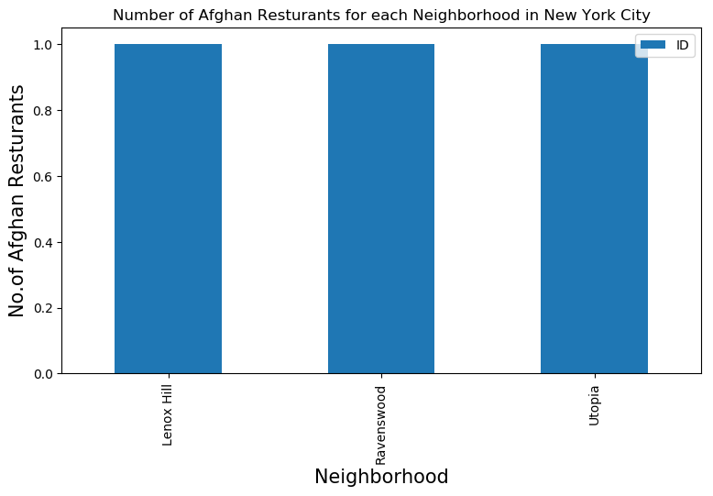
Neighbourhoods that have Afghan restaurants
The three Neighbourhoods to go to for Authentic Afghan Food are
Lenox Hill
Ravenswood
Utopia

Slide 7
Best Restaurants based on ratings, tip, likes:-
The restaurant with the most likes:-
Borough-Queens
Neighbourhood- Utopia
Name -Bakhter Afghan Halal Kababs
Likes -23
Rating- 7.3
Tips -21

Slide 8
Best Restaurants based on ratings, tip, likes:-
The restaurant with the highest rating:-
Borough- Manhattan
Neighbourhood –Lenox Hill
Name-Afghan Kebab House II
Likes- 19
Rating 7.8
Tips 11

Slide 9
Best Restaurants based on ratings, tip, likes:-
The restaurant with the most tips:-
Borough-Queens
Neighbourhood- Utopia
Name -Bakhter Afghan Halal Kababs
Likes -23
Rating- 7.3
Tips -21

Slide 10
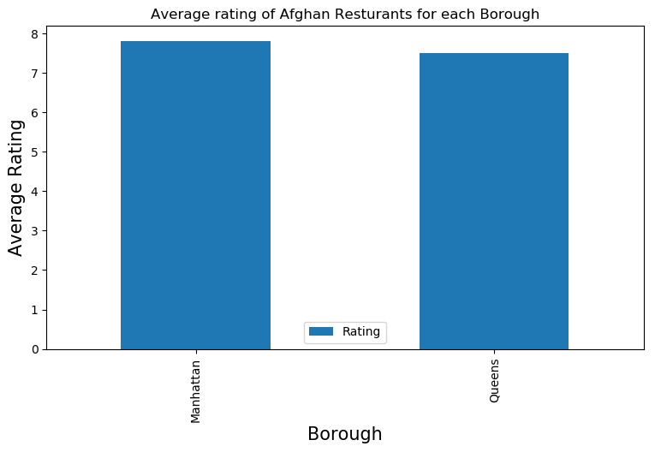
Average rating of restaurants in each borough
It is seen that the Borough of Manhattan has the highest rating which means it is the best place to stay.

Slide 11
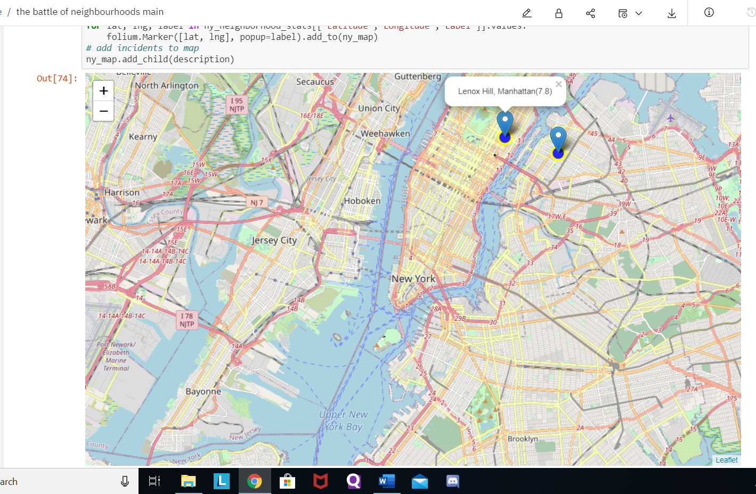
Map of Restaurants with ratings greater than 7.5
We can observe from this that there are only two restaurants that have a rating more than 7.5.
It is from this we can say that opening an Afghan Restaurant in New York is a great idea in Manhattan as there is a lack of competition.

Slide 12
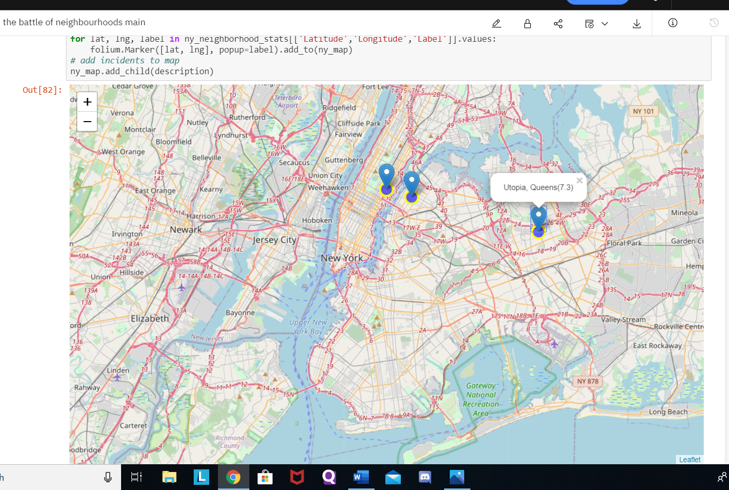
Map of all Restaurants in New York
We tried to use a chorpleth map but as the number of restaurants are very few it does not work efficiently.
I have mentioned the code for a chorpleth map in the report.
This map shows us that you would want to stay in Queens or Manhattan if you want Afghan food.

Slide 13
Conclusion
Ravenswood(Queens), Lenox Hill(Manhattan) have are some of the best neighborhoods for Afghan cuisine.
Utopia(Queens) has an Afghan Restaurant with the lowest rating.
Queens have potential Afghan Restaurant Market(As Queens has a couple of restaurants that are successful but yet not rated very highly).
Manhattan is the best place to stay if you prefer Afghan Cuisine as it has the highest rated restaurants as well as is close to other restaurants located in the nearby Borough(Queens).

Slide 14
Future and Discussions:-
Though machine learning techniques such as K-means Clustering, using a chorpleth map were planned out and a lot of time and effort was spent on learning how to go about this project, but due to the lack of information provided by the API we were only able to do our analysis to a certain extent.
One could use googles API which seem to provide a more number of restaurants but as this project involves Four Square API I was not able to go about the developer options for using another API.
The ranking is purely on basis of rating of restaurants. The accuracy of data depends purely depends on the data provided by Four Square.
It is seen that for someone who has come to this country from Afghanistan as an asylum seeker, there are very few options in terms of Authentic home food available in the city.
There is a good opportunity to start Afghan restaurants as they are popular, but however they haven’t been well established which implies there is a lack of competition.

